Slide 1
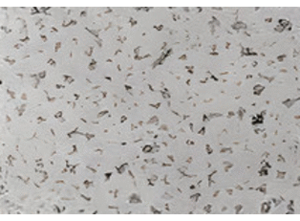
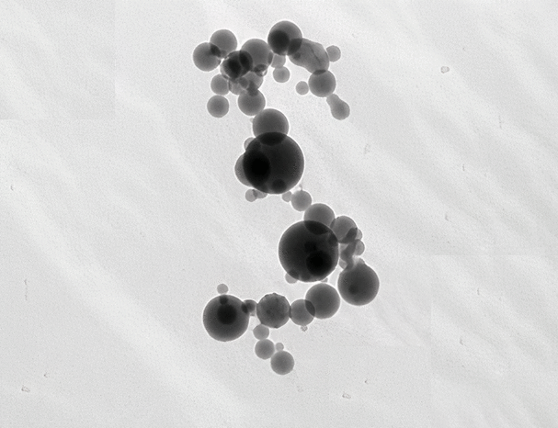


Optical properties of coated black carbon aggregates with changing size, morphology, and composition

Slide 2
Optical properties of coated black carbon aggregates with changing size, morphology, and composition
Baseerat Romshoo
Second Ph.D. Talk
22/10/2020
Ph.D. Committee : Prof. Dr. Alfred Wiedensohler, Prof. Dr. Johannes Quaas, and Prof. Dr. Harmut Herrmann.
Notes:
Good morning PAUSE
Welcome to my second phd talk PAUSE
Today, I will be talking about the optical properties of coated black carbon aggregates with changing size, morphology, and composition. PAUSE
I thank the members of my supervision and Ph.D. comitee present here today. PAUSE

Slide 3
Optical properties of coated black carbon aggregates with changing size, morphology, and composition
Contents
Background
Modelling and parametrization
Experimental validation
Summary
Outlook
Notes:
I will start my presentation with a brief background. PAUSE
Then, talk about modelling and parametrization. PAUSE
Followed, by the experimental validation study. PAUSE
Finally, a brief summaty and outlook. PAUSE

Slide 4
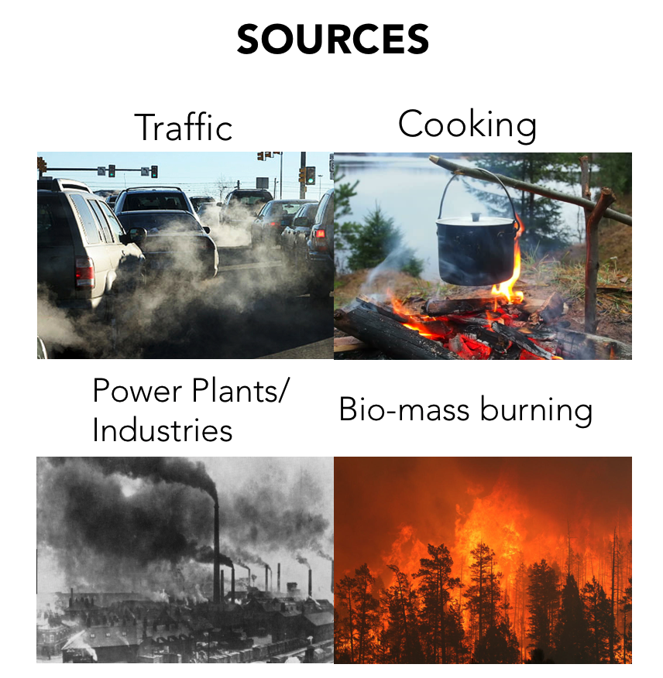
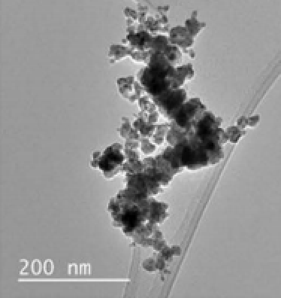
Background
1. Modeling & Parametrisation
2. Experimental Validation
Summary
Outlook
Black Carbon?
Black Carbon (BC) belongs to the fine particulate matter.
These particles strongly absorb solar radition.
Lie et al., 2008.
Google.
Notes:
These particles are particularly in interest of climate science because of their strongly absorbing nature. PAUSE

Slide 5


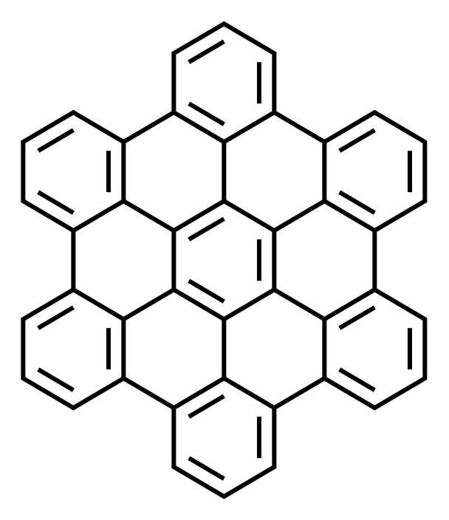
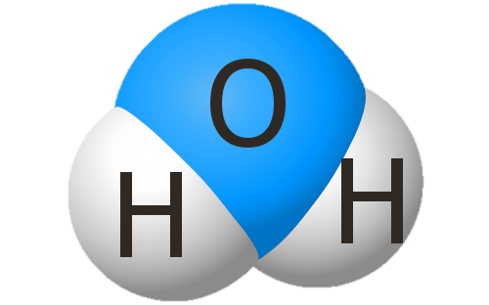
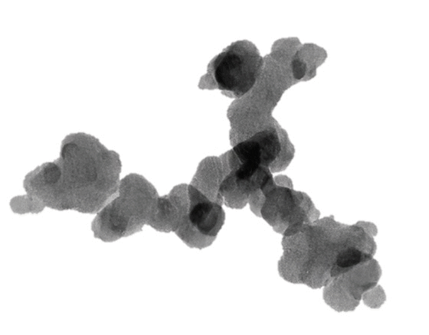
Background
1. Modeling & Parametrisation
2. Experimental Validation
Summary
Outlook
At microscopic level…
BC particles consist of agglomerates made up of numerous primary particles
Black Carbon Fractal Aggregates (BCFAs)
BCFAs undergo various modifications in shape, size and composition after emission by:
Condensation of water vapour
Coating of organics
Aggregation process
Organics
Water vapor
Notes:
These black carbon fractal aggregates undergo various modification in shape, size, and composition over time. PAUSE
This might be due to condensation of water vapour over them. PAUSE
Or deposition of organics which are byproducts of burning. PAUSE
Or by aggregation of smaller black carbon aggregates. PAUSE

Slide 6
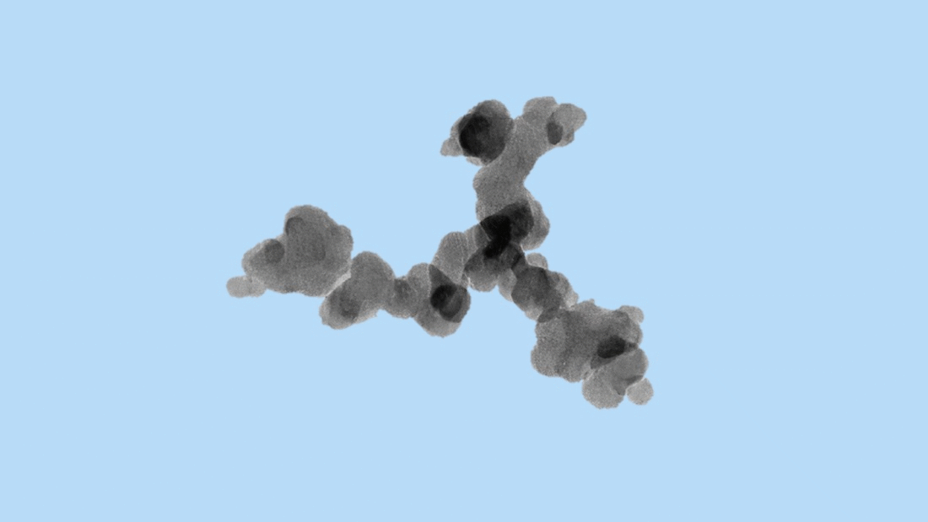
Background
1. Modeling & Parametrisation
2. Experimental Validation
Summary
Outlook
Consequence of modifications in BCFAs
Modifications in BCFAs
Radiative and microphysical properties of aersols and clouds
Influences BCFA
optical properties
We are interested to quantify how modifications in:
Size
Morphology
Composition
of BCFAs influence their optical properties.
Notes:
We are interested to study this part, that is PAUSE
To quatify how modifications in size, morphology, and composition of black carbon fractal aggregates influence their optical properties. PAUSE

Slide 7

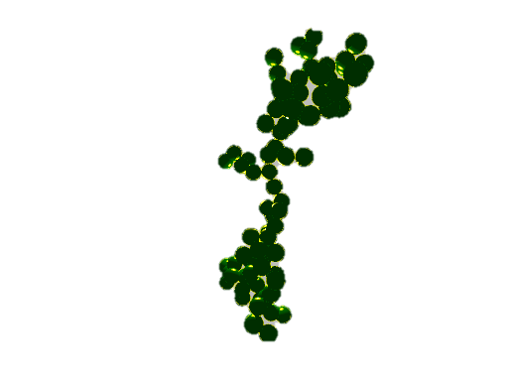
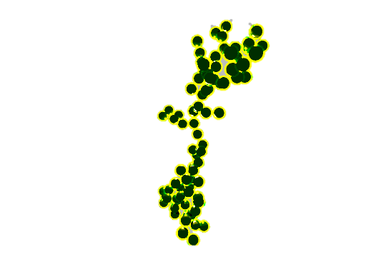
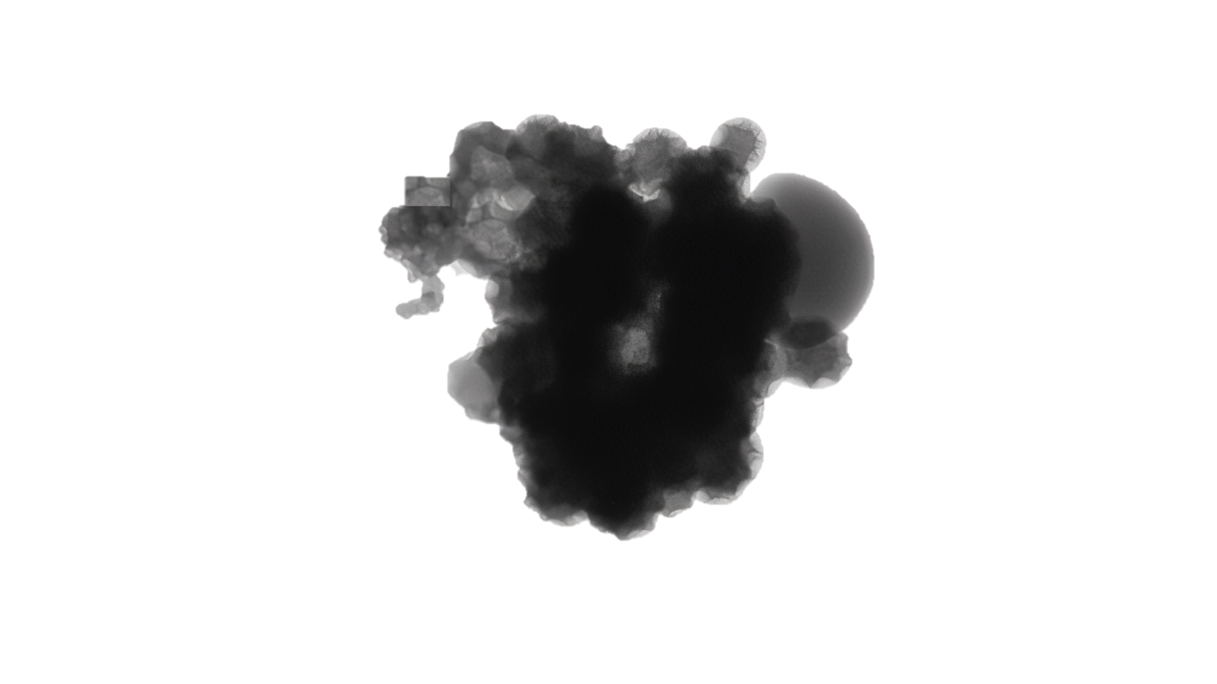
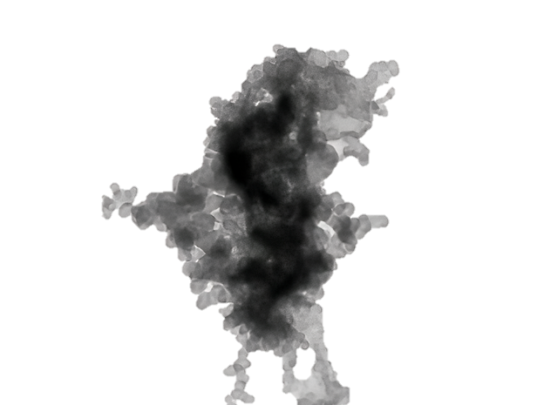
Modifications in Black Carbon Fractal Aggregates (BCFAs)
Outlook
Background
1. Modeling & Parametrisation
2. Experimental Validation
Summary
Size
Mobility diameter (D_{mob}) ≳ 2 D_{vol}
Volume equivalent diameter (D_{vol})
Primary particle radius (R_{pp})
Morphology
Fractal dimension (D_{f})
Composition
Volume fraction of Organics (f_{organics})
The modifications can be studied by simulating various cases and modelling their optical properties
Notes:
All these modifications can be studied by simulating various case and calculating their optical properties.
So, this is what we baiscially plan to do.

Slide 8

Ph.D. workplan
Summary
Outlook
Background
1. Modeling & Parametrisation
2. Experimental Validation
Goal: Investigate the modifications in BCFAs and their optical properties
Obj.1
Modelling & parametrization
Simulate BCFAs of various size, shape, or composition
Quantify the changes in optical properties
Parametrization scheme
Obj.2
Experimental validation
Laboratory generated soot:
Data for input parameters (size and composition)
Validation of modelled optical results
Obj.3
Optimized experiments
In depth validation of optical modelling techniques
Notes:
This is my summarized Ph.D. work plan. PAUSE
From this you will get a overview of what I will be talking about today.
The goal is to investigate the modifications in BCFAs and their optical properties. PAUSE
The first part is modelling and parametrisations. PAUSE
I will be simulating BCFAs of various size, morphology, and compostion and quantifying the changes in the optical properties.
Further, a parametrisation scheme for optical properties is developed. PAUSE
The second part is experimental validation, where I compare the model results to the laboratory results from the EMPIR BC prokect. PAUSE
And the last objective is optimized experiments, where we will be further validating the modelling techniques. PAUSE
In today's talk I will be talking about part 1 MAINLY and part 2 BRIEFLY

Slide 9
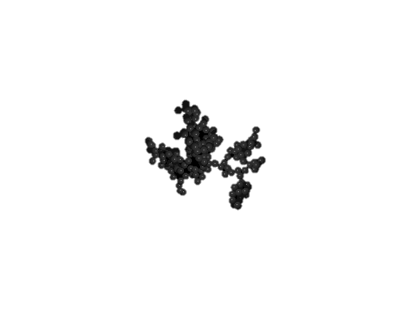
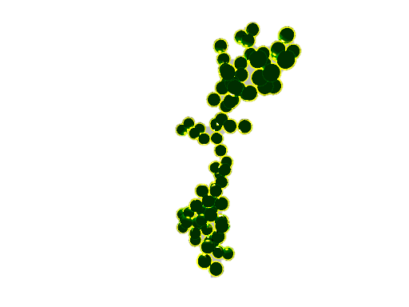



Background
1. Modeling & Parametrisation
2. Experimental Validation
Summary
Outlook
Introduction : 1. Modeling & Parametrisation
Optical modelling
Key: Representation of BC particles
Aggregate
Coated aggregate
Aggregate + spherical coating
Single sphere
Coated sphere
Homogeneously mixed sphere
Simulate lifecycle of BC particles
(Dong et al., 2018; Ouf et al., 2016)
Wide parameter space
Widely used
Simpler
Larger descrepancies (Wu et al., 2018; Adachi et al., 2010)
Modelling the optical properties of coated black carbon fractal aggregates (BCFAs) with changing size, morphology, and composition
Wide parameter space of BCFAs.
Parametrization scheme for optical properties (extinction, absorption, and scattering).
Notes:
They two key aspects of this study are that:
An wide parameter space of BCFAs are used NEVER USED BEFORE
A parmetrisation scheme for optical properties of BCFA are developed ALSO DONE FOR THE FIRST TIME

Slide 10
Background
1. Modeling & Parametrisation
2. Experimental Validation
Summary
Outlook
Wide parameter space of BCFAs
Size
The BCFAs are simulated following this parameter space
Total of 192 cases.
Mobility diameter (D_{mob})
60nm…………………
50nm
900nm
1000nm
Morphology
Pure BC
Coated BC
Fractal dimension (D_{f})
Fractal dimension (D_{f})
1.5
1.6………
1.5
1.6………
2.1
2.2
2.7
2.8
Composition
Volume coating fraction (f_{organics})
Wavelength
80%
90%
1%
5%.....................
467nm
530nm
660nm
467nm
530nm
660nm
Notes:
So, the black carbon fractal aggregates are simulated following this parameter space. PAUSE
In total, we have 192 cases. PAUSE

Slide 11
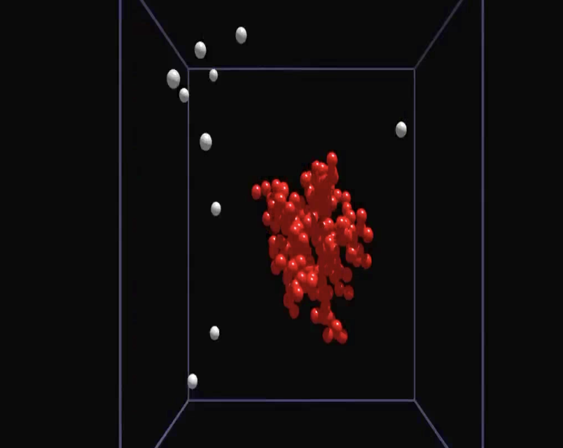
Background
1. Modeling & Parametrisation
2. Experimental Validation
Summary
Outlook
Simulation of BCFAs
Tunable diffusion limited aggregation software to generate the black carbon aggregate simulations. (Woźniak, 2012)
BC core of primary particle fixed to 15nm
Increase the outer core size up to 30 nm according to the f_{organics} %
Size of BCFAs
Modelling studies use ”number of primary particles” to represent size.
(Smith and Grainger, 2014; Kahnert, 2010; Zhang et al., 2017)
We used mobility diameter → conversion based on model by Sorensen, 2011.
Notes:
Previous modelling studies used number of primary particles to represent the size. PAUSE
In our study, we used the mobility diameter based on a convertion developed from a model by Sorensen. PAUSE
This makes the results from this study, more applicable for ambient or labarotory studies. PAUSE

Slide 12
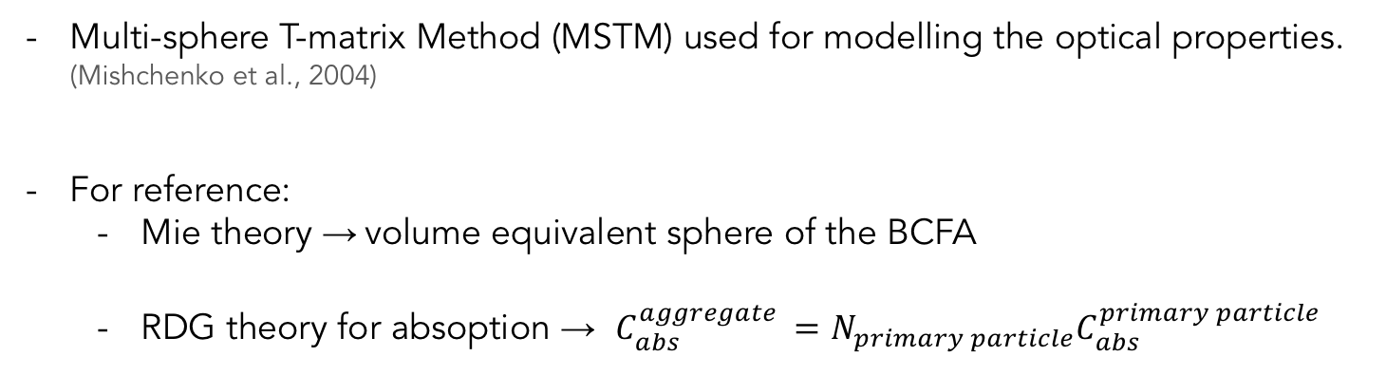
Background
1. Modeling & Parametrisation
2. Experimental Validation
Summary
Outlook
Optical model
Multi-sphere T-matrix Method (MSTM) used for modelling the optical properties. (Mishchenko et al., 2004)
For reference:
Mie theory → volume equivalent sphere of the BCFA
RDG theory for absoption → $C_{abs}^{aggregate }=N_{primary particle}C_{abs}^{primary particle}$
Optical results
Extinction, absorption, and scattering cross section (C_{ext/abs/sca} )
Asymmetry parameter (g)
Single scattering albedo (SSA)
Mass absorption cross-section (MAC)
Absorption Ångstrom Exponent (AAE)
Absorption enhancement factor (E_{𝜆})
Notes:
In this talk, I will be discussing in detail the mass absorption cross section and absorption angstrom exponent.

Slide 13
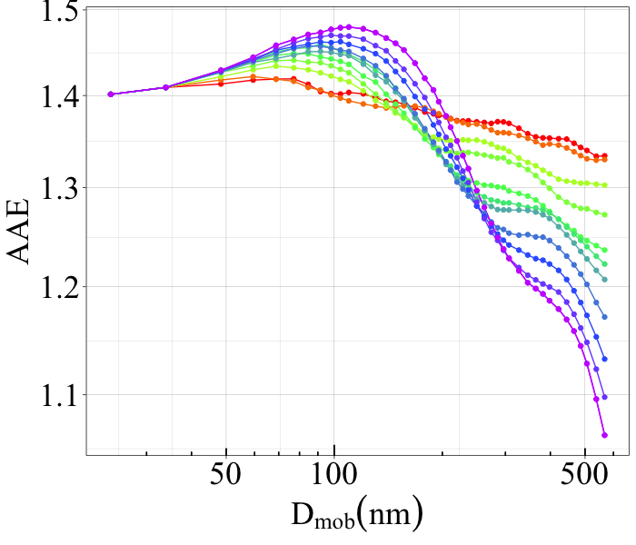
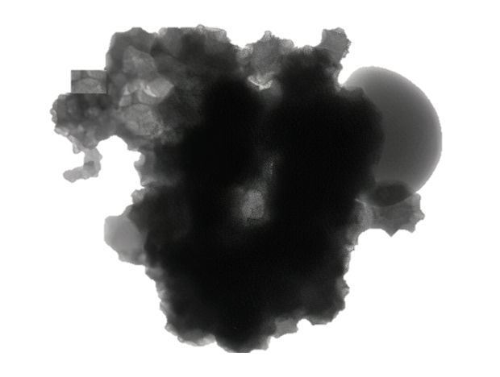
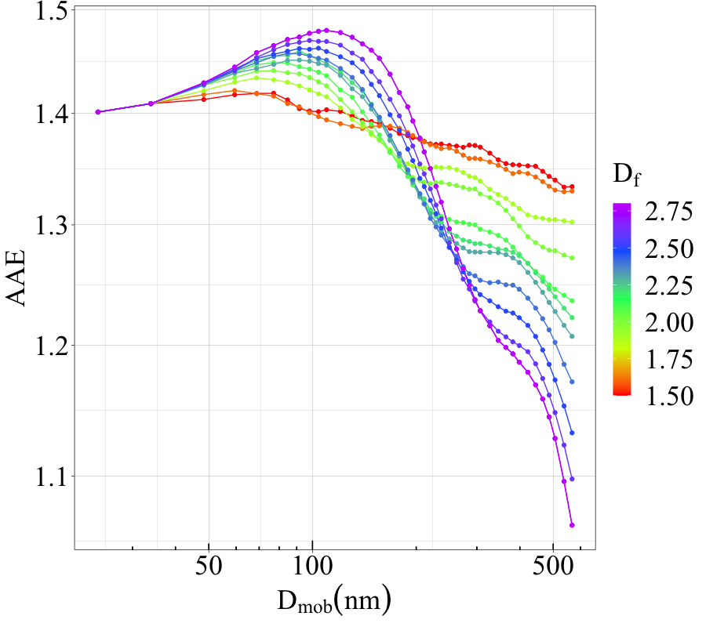
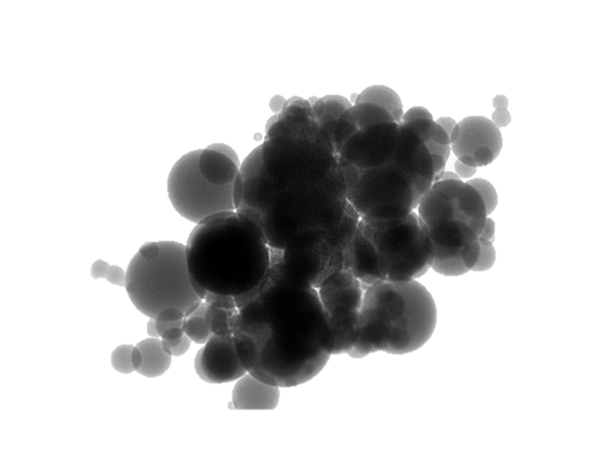
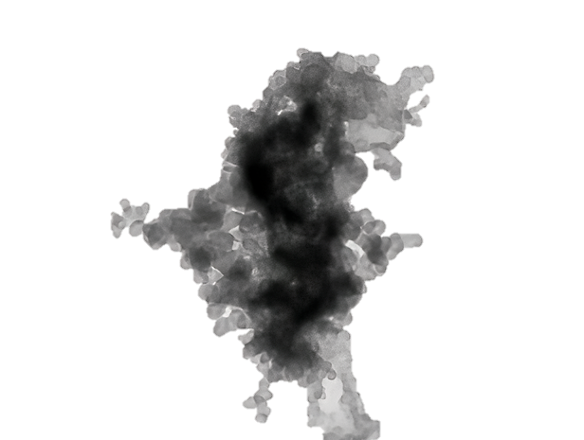
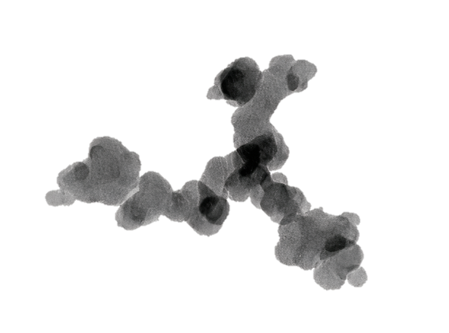
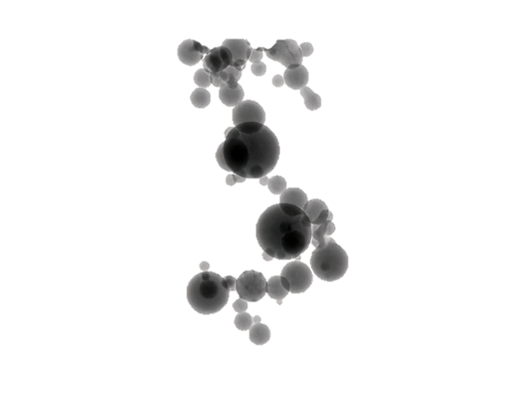
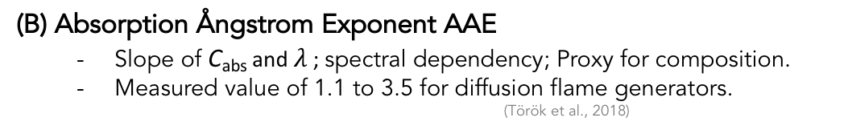
Background
1. Modeling & Parametrisation
2. Experimental Validation
Summary
Outlook
Results: Changing morphology (D_{f}) of BCFAs
Mass Absorption Cross-section MAC_{BC}
Measure of probability of absorption
Measured value of 4.55 to 18.5 m²/g at 550nm.
(Zanatta et al, 2016)
(B) Absorption Ångstrom Exponent AAE
Slope of C_{abs} and $λ$ ; spectral dependency; Proxy for composition.
Measured value of 1.1 to 3.5 for diffusion flame generators.
(Török et al., 2018)
Pure BC case
f_{organics} = 0%
Dominant effect in larger sizes
AAE depends on morphology
Varying behavior with morphology
Notes:
Absorption angstrom exponent is used as a proxy for composition. PAUSE
It might be assumed that this quantity depends over composition only. PAUSE
But we see from our results, the Absorption angstrom exponent has a complex dependency on morphology. PAUSE

Slide 14
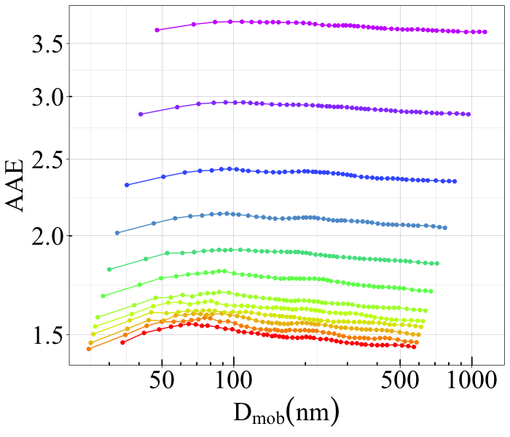

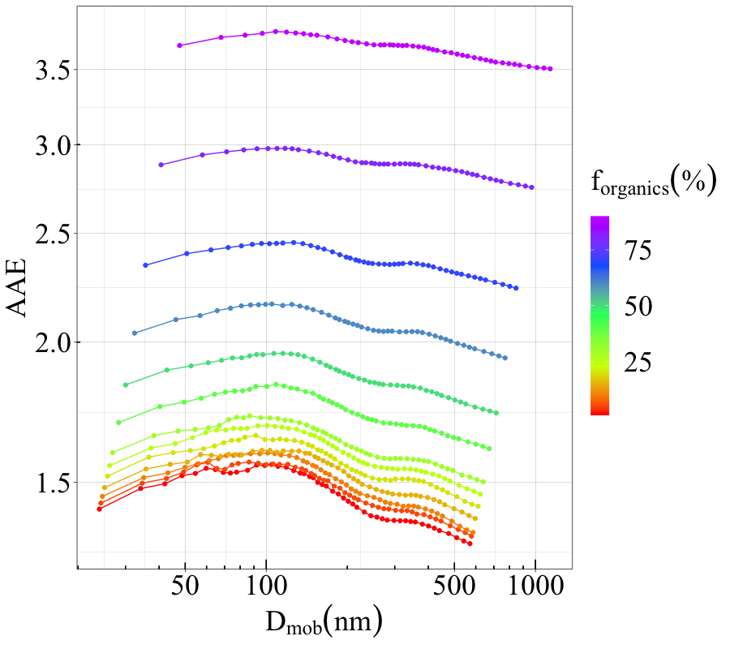



Background
1. Modeling & Parametrisation
2. Experimental Validation
Summary
Outlook
Results: Changing composition (f_{organics}) of BCFAs
Mass Absorption Cross-section MAC_{BC}
Measure of probability of absorption
Measured value of 4.55 to 18.5 m²/g at 550nm.
(Zanatta et al, 2016)
(B) Absorption Ångstrom Exponent AAE
Slope of C_{abs} and $λ$ ; spectral dependency; Proxy for composition.
Measured value of 1.1 to 3.5 for diffusion flame generators.
(Török et al., 2018)
D_{f} = 2.2
0
Message: Dependency on composition is straight forward, whereas a complex dependency on morphology
Notes:
The important message is that the dependency of MAC and AAE on composition is pretty straight forward. PAUSE
Whereas it has complex dependency on morphology as seen from the results in the earlier slide. PAUSE

Slide 15
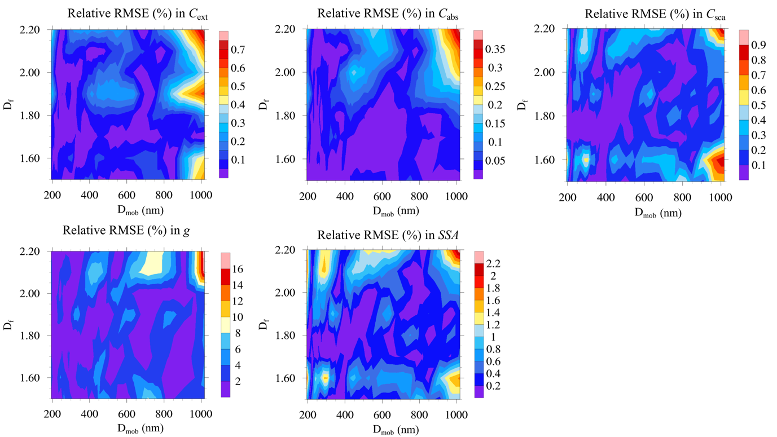
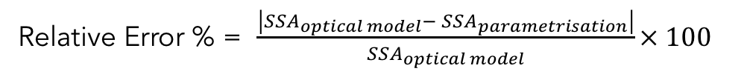
Background
1. Modeling & Parametrisation
2. Experimental Validation
Summary
Outlook
Parametrization scheme
A parametrization scheme for optical properties of coated BCFAs w.r.t mobility diameter.
Applicable for modelling, ambient and laboratory-based BC studies.
Example: Single Scattering Albedo
$lnSSA= k_{0}+ k_{1}lnD_{mob}+ k_{2}ln⁡(lnD_{mob})$
$k_{0}$, $k_{1}$, and $k_{2}$ vary according to 192 sub-cases of morphology, composition, and wavelength.
Relative error (%) in SSA
Error Analysis
Relative Error % = $\frac{\left|{SSA}_{optical model}− {SSA}_{parametrisation}\right|}{{SSA}_{optical model}}× 100$
Sub-case:
f_{organics} =50%
𝜆 = 660nm
D_{f} = 1.5 to 2.2
Optical property | Relative Error (%)
Cross-sections | <2
SSA | <3
g | <18
MAC | -
AAE | -
Notes:
It was not possible to show similar results for the entire set of cases.PAUSE
So we did a statistically measures the average errors for the entire dataset.PAUSE
Overall for the entire dataset, we has promising errorof 2% for cross sections,3% for asymmetry parameter, and 18% for SSA. PAUSE
Unfortuantely, it was not possible to find a fit for MAC and AAE representative for the entire dataset. PAUSE
But overall we are happy that we were able to produce many results and understand various dependencies, and in addition provide a parametrization scheme. PAUSE
So, this was a summarized version of what was done in modelling and parametrization. PAUSE

Slide 16
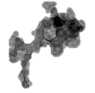
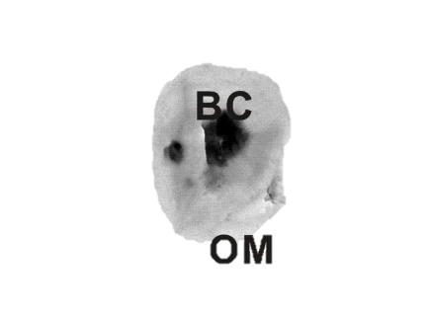
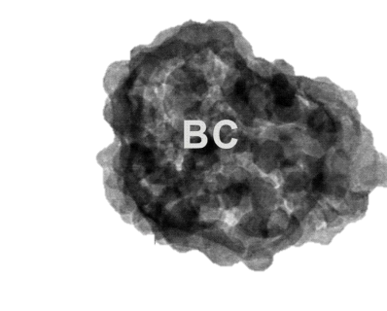
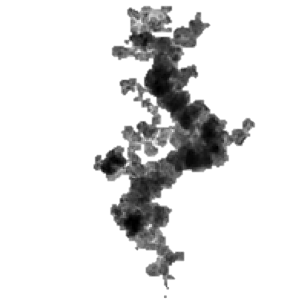
Background
1. Modeling & Parametrisation
2. Experimental Validation
Summary
Outlook
2. Experimental validation : Introduction
How representative are these soot models with respect to laboratory/ambient measurements?
LABORATORY/AMBIENT
Optical modelling studies of soot:
Liu et al., 2015; Smith and Grainger, 2014; Kahnert 2010; Zhang et al., 2017.
Optical instruments:
Aethelometers, Nephelometers, Cavity Attenuated Phase Shift extinction (CAPS PMex) monitors, and Multi Angle Absorption Photometer (MAAP).
Obj. 2:
Laboratory generated soot for validation of optical modelling techniques
Notes:
And this is what we wanted to answer in this study, that is use the laboratory generated BC for the validation of various modelling techniques of black carbon.

Slide 17


Methodology
Summary
Outlook
Background
1. Modeling & Parametrisation
2. Experimental Validation
MPSS - Particle size measurements
LABORATORY CAMPAIGNS
EC/OC analysis - composition measurements
Soot generators
🔥
mini-CAST
🕯
Inverted flame generator
⚡️
PALAS spark generator
Fullerene soot
AE33, MAAP, Nephelometer
OPTICAL PROPERTIES
⚫️
CAPS PM_{ex660}, CAPS PM_{ex530}, CAPS PM_{ex450}
Validation
Notes:
Finally, we validate the modelled optical properties to the measured optical properties from the laboratory measurements to draw comparisons. PAUSE

Slide 18
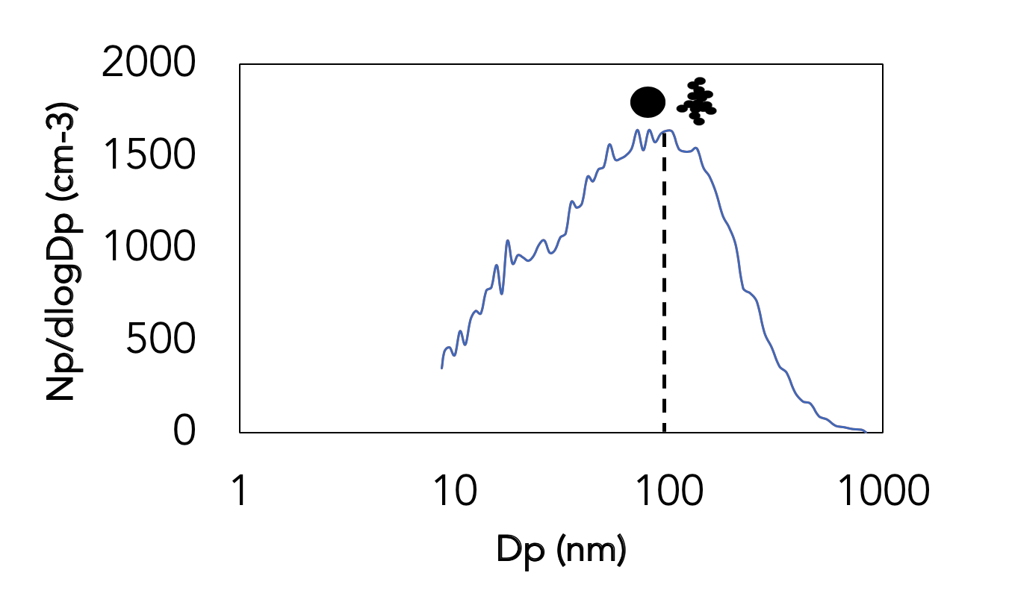
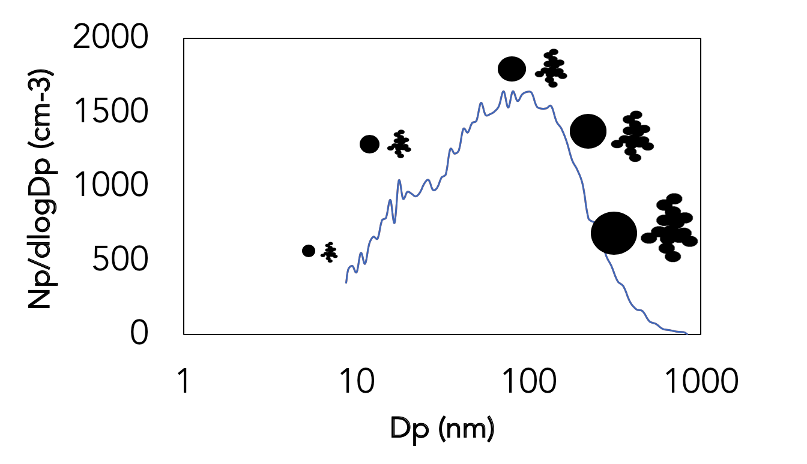
Modelling approaches
Summary
Outlook
Background
1. Modeling & Parametrisation
2. Experimental Validation
BC model
- Various BC representation models were used
Single sphere
Coated sphere
Homogeneous mixed sphere
Aggregate
Coated Aggregate
Aggregate with spherical coating
Particle size
NSD or VSD
BULK
or
Point approach: optical results at the mean mobility diameter of the number or volume size distribution.
Bulk approach: optical results integrated over entire number size distribution.
Number size distribution (NSD) or volume size distribution (VSD)
Notes:
Whereas, in the bulk approach . PAUSE
The optical results are integrated over the entire number size distribution. PAUSE

Slide 19
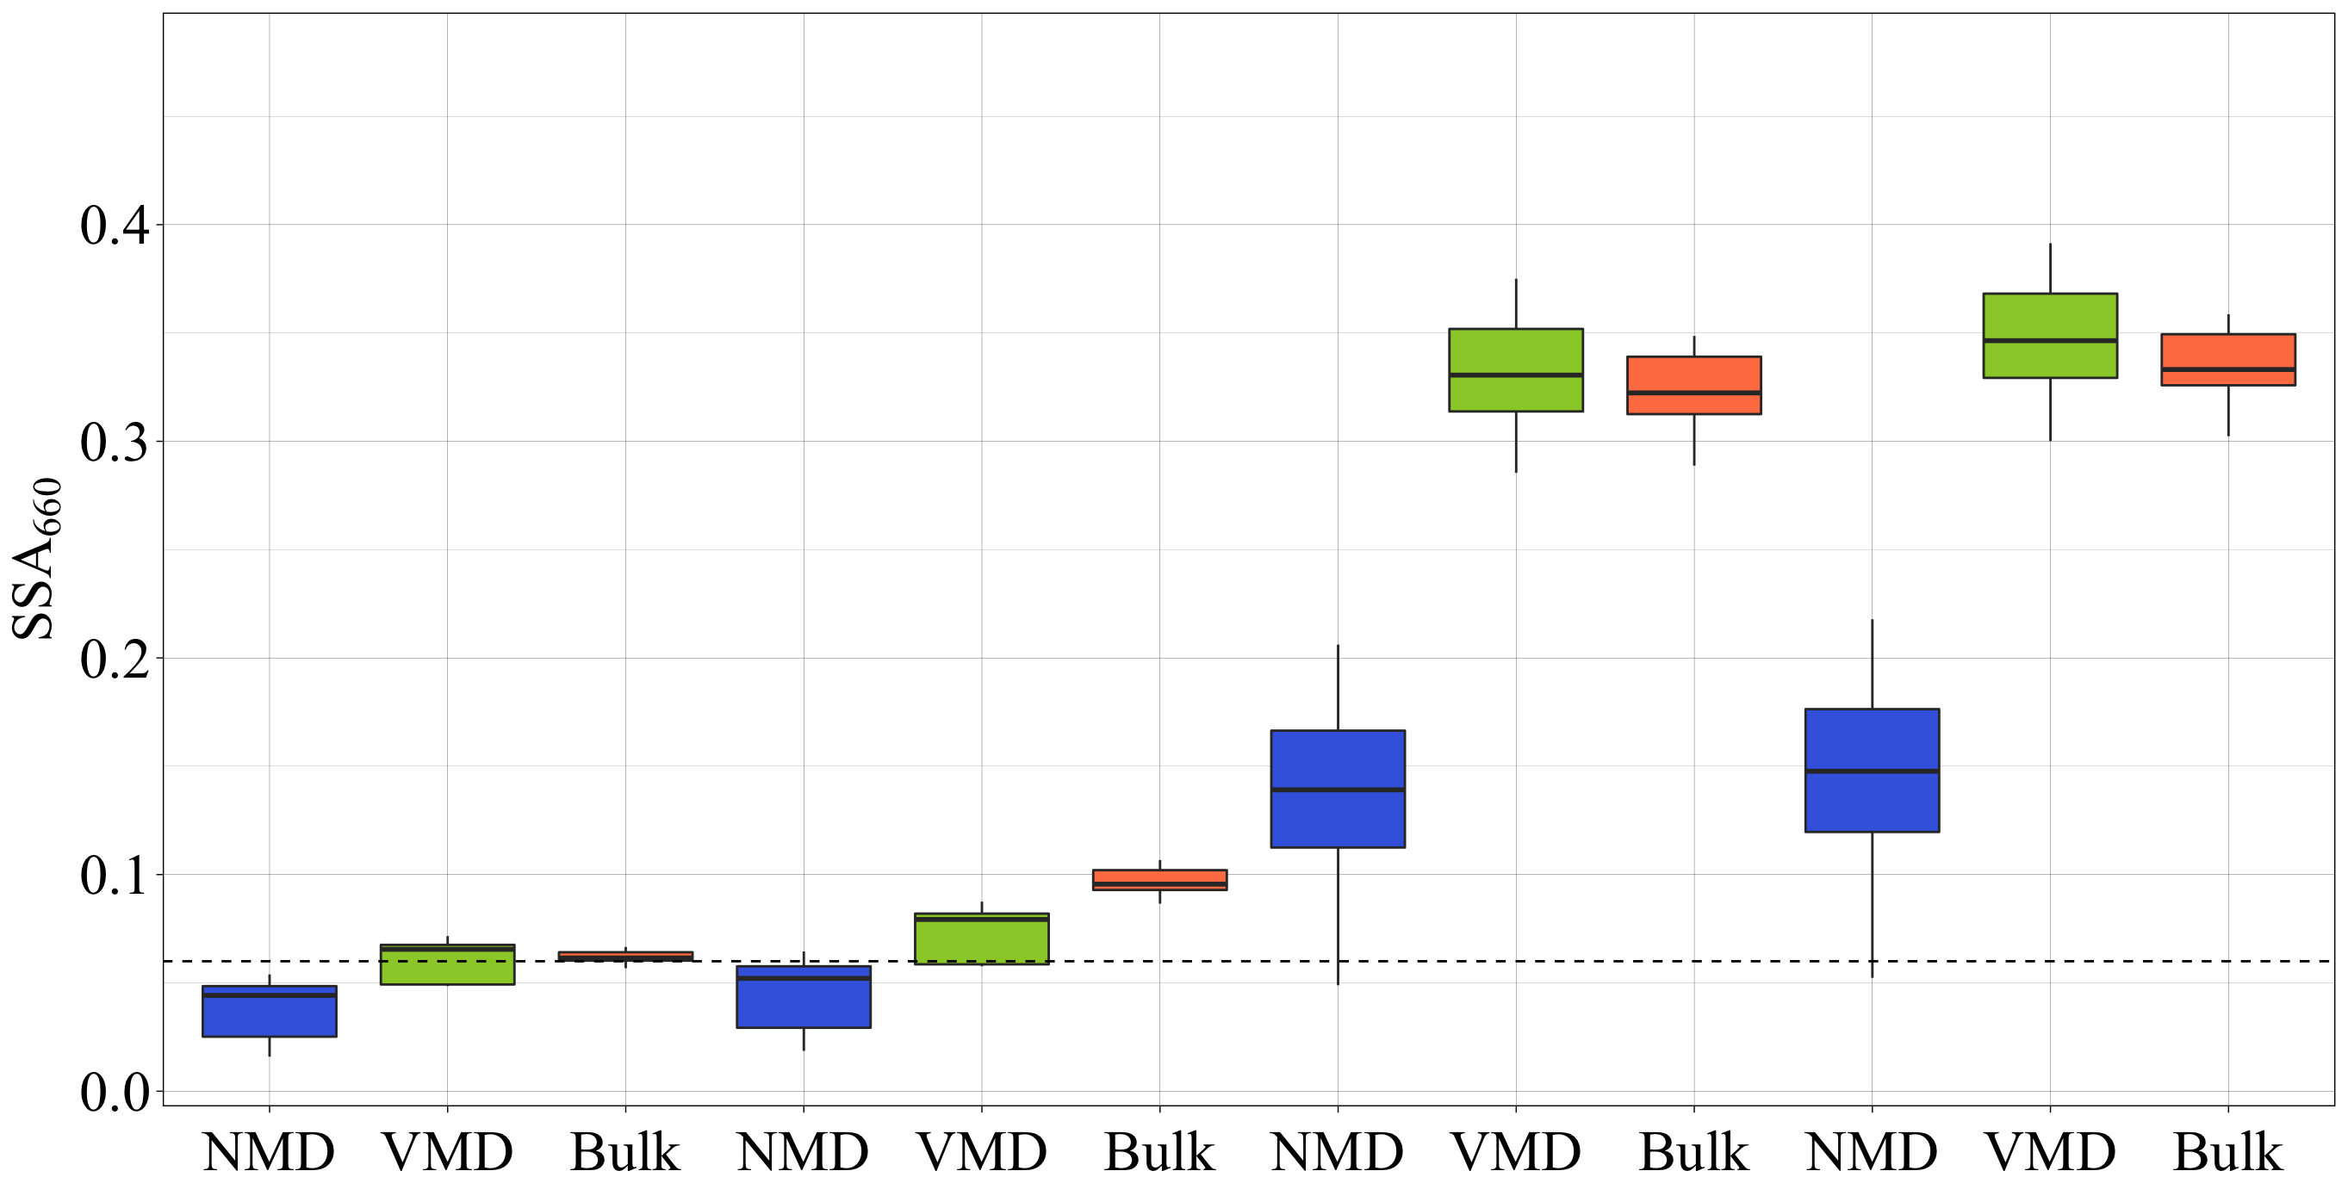
Experimental SSA vs modelled SSA
Outlook
Background
1. Modeling & Parametrisation
2. Experimental Validation
Summary
Ideal case (low organic content)
NMD = 129nm
VMD = 181nm
EC/TC = 0.68
mini-CAST 5201BC
🔥
Accuracy of 40 - 90% of modelling technique
Experiment
Coated aggregate
Aggregate with spherical coating
Homogeneously mixed sphere
Coated sphere
Notes:
In this case, the aggregate representations have a promising accuracy of up to 90%. Which is great.
The bulk shows most accuracy. PAUSE
It is time consuming but better since it is representative of the entire size distribution.
So, in a case of low organic content, these two representations are the best match.

Slide 20
Experimental SSA vs modelled SSA
Outlook
Background
1. Modeling & Parametrisation
2. Experimental Validation
Summary
Case of higher organic content
NMD = 112nm
VMD = 157nm
EC/TC = 0.55
mini-CAST 5203C
🔥
In this case, the aggregate representation underestimates the SSA
Morphology might be different than the expected literature value of D_{f} = 1.7 for freshly emitted soot.
Experiment
Coated aggregate
Aggregate with spherical coating
Homogeneously mixed sphere
Coated sphere
Notes:
But, we can clearly see that in this case, the aggregate representationn underestimates the single scattering albedo. PAUSE
This might be becase as the organic content increases, the morphology of the aggregates changes to a more spherical structure. AND NOT FRESHLY EMITED AGGREGATES
And in our modeling approach we used the morphology from previous literature studies which are not sensitive to this fact. PAUSE
Therefore, we see that the morphology of BC can be a tricky parameter, especially if we want to model optical properities that closely resemble the laboratory measurement. PAUSE
And we will be investigating these area more to understand better what is happening there. PAUSE

Slide 21
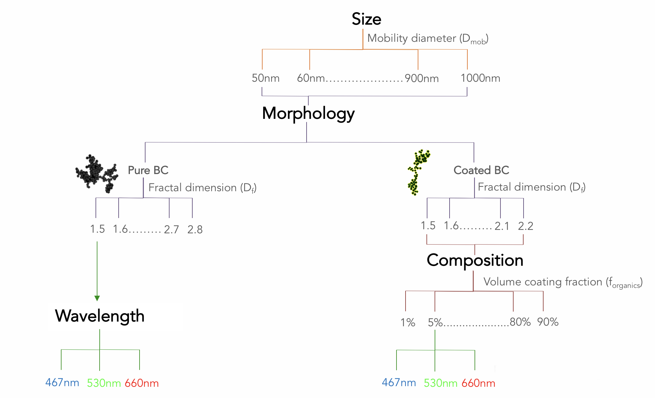

Summary
Background
1. Modeling & Parametrisation
2. Experimental Validation
Summary
Outlook
1. Modelling & parametrisation
Optical properties of BCFAs were investigated as a function of particle size (D_{mob}), morphology (D_{f}), composition (f_{organics}), and wavelength (𝜆)
Parametrization scheme for BCFAs optical properties was developed, applicable for modelling, ambient and laboratory-based BC studies.
2. Experimental validation
Modelling techniques are validated with their experimental equivalent results.
For the low organics case, aggregate representation match to the experimental values, with an accuracy ranging between 40 – 90%.
Notes:
For low organics case, Aggregate representation match to the experimental equivalent values, with an accuracy ranging between 40 – 90

Slide 22
Outlook
Background
1. Modeling & Parametrisation
2. Experimental Validation
Summary
Outlook
Optical modelling of BC particles can be a key tool in reproducing laboratory or ambient optical measurements.
Finding the best representation of BC particles for optimal modelling results can be challenging due to complex changes in their morphologies.
Optimized laboratory experiments must be conducted to reduce the discrepancies in modelled optical properties:
In addition to present size and composition measurements:
Estimates of fractal dimension (morphology) ⟹ DMA-CPMA system
Estimates of primary particle size ⟹ TEM analysis
Improvement in accuracy
Notes:
This can be done by, in addition to the size and composition measurements. PAUSE
We measure the fractal dimension by a combination of DMA-CPMA system. . PAUSE
And the primary particle radius from th TEM analysis. . PAUSE
In order to improve the accuracy. . PAUSE

Slide 23

Ph.D. Progress
Summary
Outlook
Background
1. Modeling & Parametrisation
2. Experimental Validation
Goal: Investigate the changes in BCFAs and their optical properties
Obj.1 – Modelling & parametrisation
Status : Completed
Paper submitted in ACP
Obj.2 – Experimental validation
Status : Further analysis of results
Romshoo et al. 2020, EAC poster (First winner, BPA 2020).
Obj.3 – Optimized experiments
Status : Experiment to be conducted by mid of 2021.
Notes:
Finally I will end my presentation with this last slide of PhD progress. PAUSE
So, the first part is completed, and the publication is under submission process. PAUSE
For the experimental validation, the status is discussion of results. PAUSE
And for this experimental validation study, we also won the BPA at the online EAC 2020. PAUSE
For the last part, the experiment is to be conducted by mid of 2021.

Slide 24
Thank you! ☺

